Slide 1
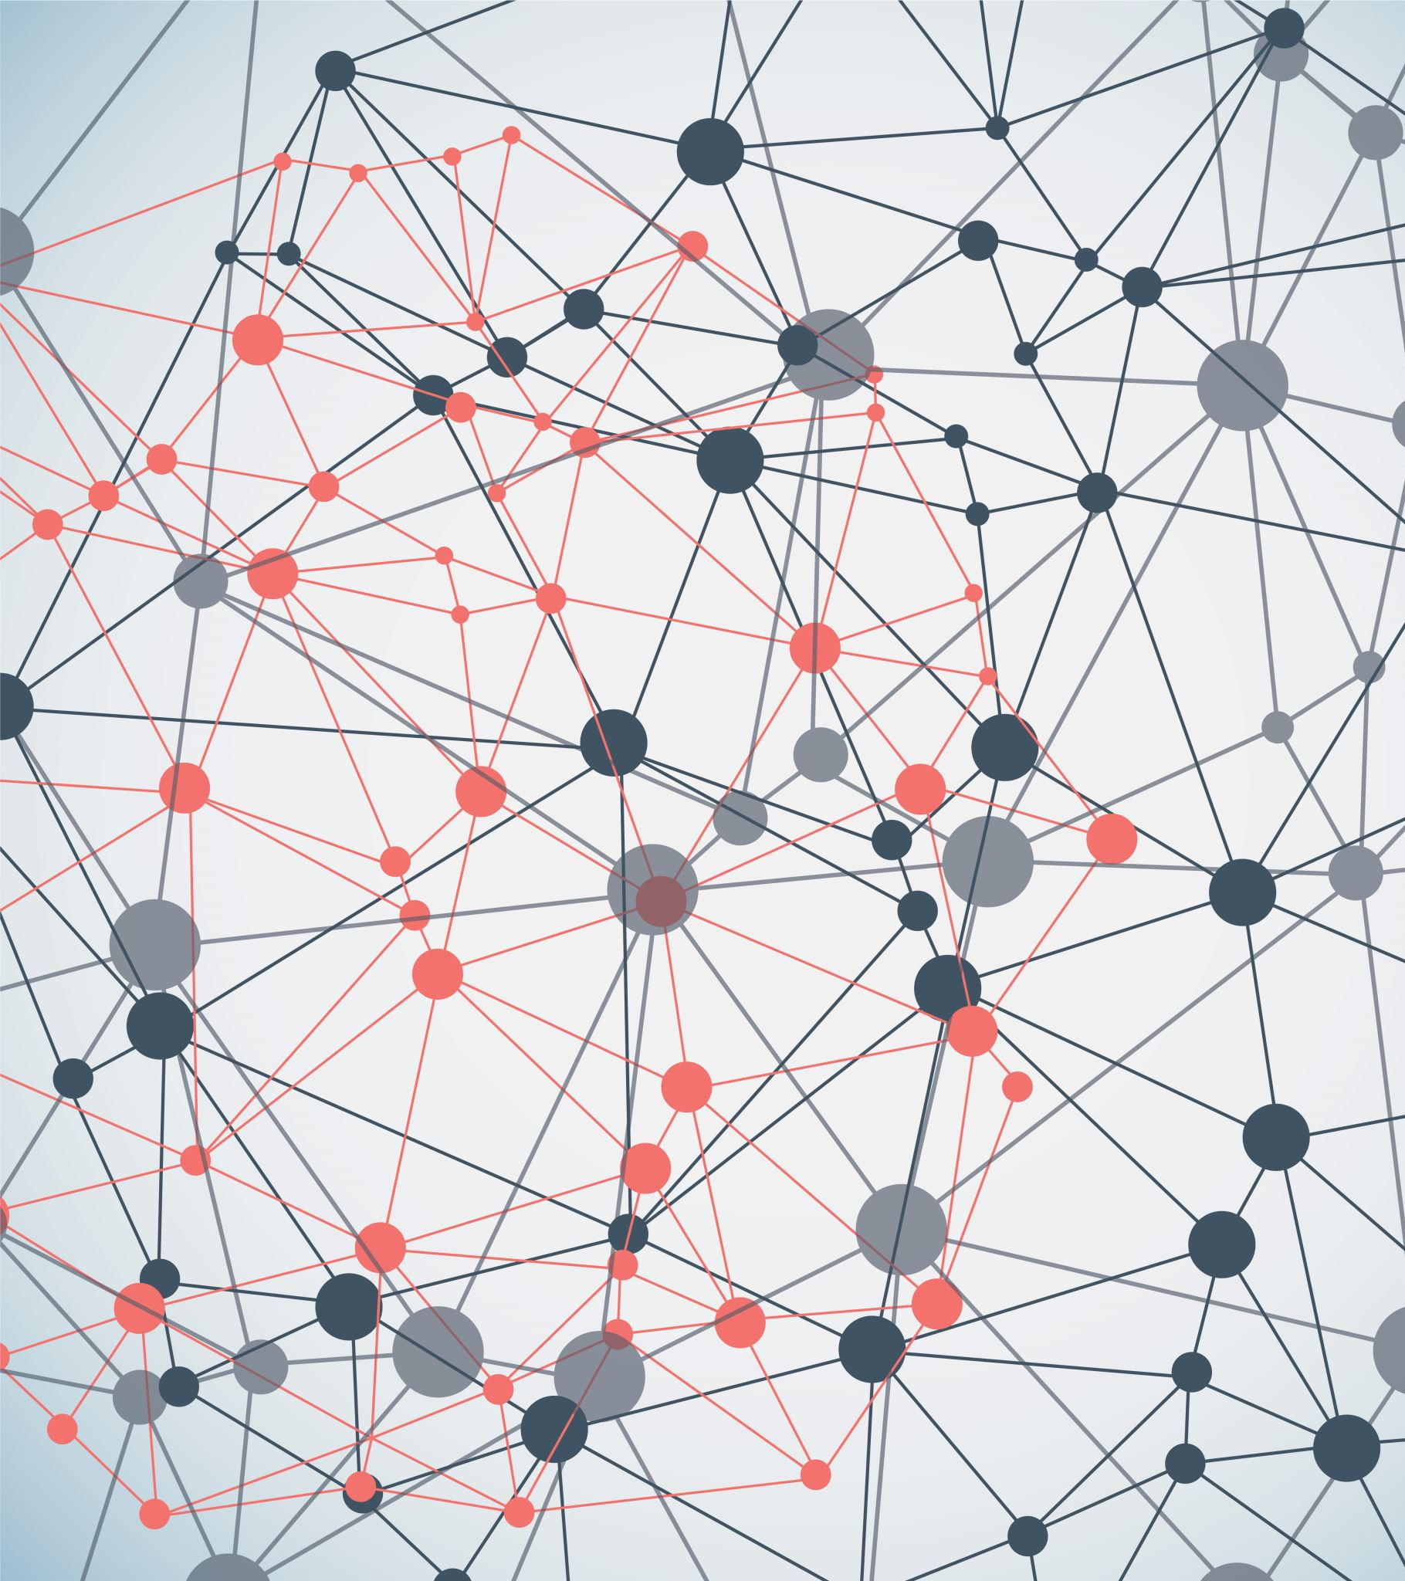
Intelligent Apps
Jae-min park
Seung-chan lee

Slide 2
What are Intelligent Apps?
Intelligent apps are pieces of software that leverage different Artificial Intelligence (AI) components such as Machine Learning (ML), Natural Language Processing (NLP), data analytics, deep learning, robotics, general intelligence, expert systems, etc.

Slide 3
Benefits of Intelligent Apps
• Offer predictions and decisions to deliver super-rich and custom-made experiences for users.
• Offer valuable solutions based on users’ history of interactions with brands, people and machines.
• Deliver personalized and contextual content to facilitate constant engagement.
• Analyse multiple data sources to deliver valuable insights and help in automating simple routine tasks without specifically waiting for user commands.

Slide 4
Example of Intelligent Apps
Netflix, one of the disruptive brands in the media industry, is the best example for leveraging intelligence systems and for developing a business model around them. Its personalized movie recommendation feature is powered by Big Data. It mainly uses explicit and implicit data.
Its powerful algorithms examine and identify patterns from data helping users to efficiently pick what to watch next. Smart use of AI helps Netflix to can build a store of knowledge that will facilitate precise user prediction.

Slide 5
Example of Intelligent Apps
Ada Health is an AI-powered ‘doctor in your pocket, app that helps users to understand their health and navigate to the most suitable care. The app launched a fresh method to personalized health, reinforced by sophisticated AI, human medical know-how and the power of mobile technology. The app has a conversational interface. It asks simple and relevant questions and compares the answers to its rich data of similar cases to deliver custom-made responses to the unique health profiles. It ultimately helps you find the best possible explanations for your symptoms. It guides users to take the most appropriate care, and track and manage their health.

Slide 6

The problem of Intelligent Apps
AI can be used to create cyberweapons.
AI will make hacking more sophisticated.
AI will spread misinformation and propaganda.
Sources : https://imaginenext.ingrammicro.com/networking-and-security/the-top-3-ai-security-threats

Slide 7
Solution of the problem of intelligent apps

Slide 8
Modeling User Behavior
Organizations use AI to model and monitor the behavior of system users. The purpose of monitoring the interactions between a system and users is to identify takeover attacks. These are attacks where malicious employees steal login details of other users and use their accounts to commit different types of cybercrimes. AI learns the user activities over time such that it considers unusual behavior as anomalies. Whenever a different user uses the account, AI-powered systems can detect the unusual activity patterns and respond either by locking out the user or immediately alert system admins of the changes.
Sources : https://www.cisomag.com/hackers-using-ai/

Slide 9
Applying AI in Antivirus Products
Antivirus tools with AI capabilities detect network or system anomalies by identifying programs exhibiting unusual behavior. Malware programs are coded to execute functions that differ from standard computer operations. AI antiviruses leverage machine learning tactics to learn how legitimate programs interact with an operating system. As such, whenever malware programs are introduced to a network, AI antivirus solutions can immediately detect them and block them from accessing systems resources. This contrasts from signature-based traditional antiviruses which scans a signature database to determine whether a program is a security threat.
Sources : https://www.cisomag.com/hackers-using-ai/

Slide 10
Automated Network and System Analysis
Automated analysis of system or network data ensures continuous monitoring for prompt identification of attempted intrusions. Manual analysis is nearly impossible due to the sheer volume of data generated by user activities. Cybercriminals use command and control (C2) tactics to penetrate network defenses without being detected. Such tactics include embedding data in DNS requests to bypass firewalls and IDS/IPS. AI-enabled cyber defenses utilize anomaly detection, keyword matching, and monitoring statistics. As a result, they can detect all types of network or system intrusion.
Sources : https://www.cisomag.com/hackers-using-ai/

Slide 11
Thank you

